Slide 1
Use of UAVs in Post-Disaster Response
PRO-LOG 2018
Sean Grogan, École Polytechnique de Montréal
Michel Gamache, Robert Pellerin
© Sean Grogan

Slide 2
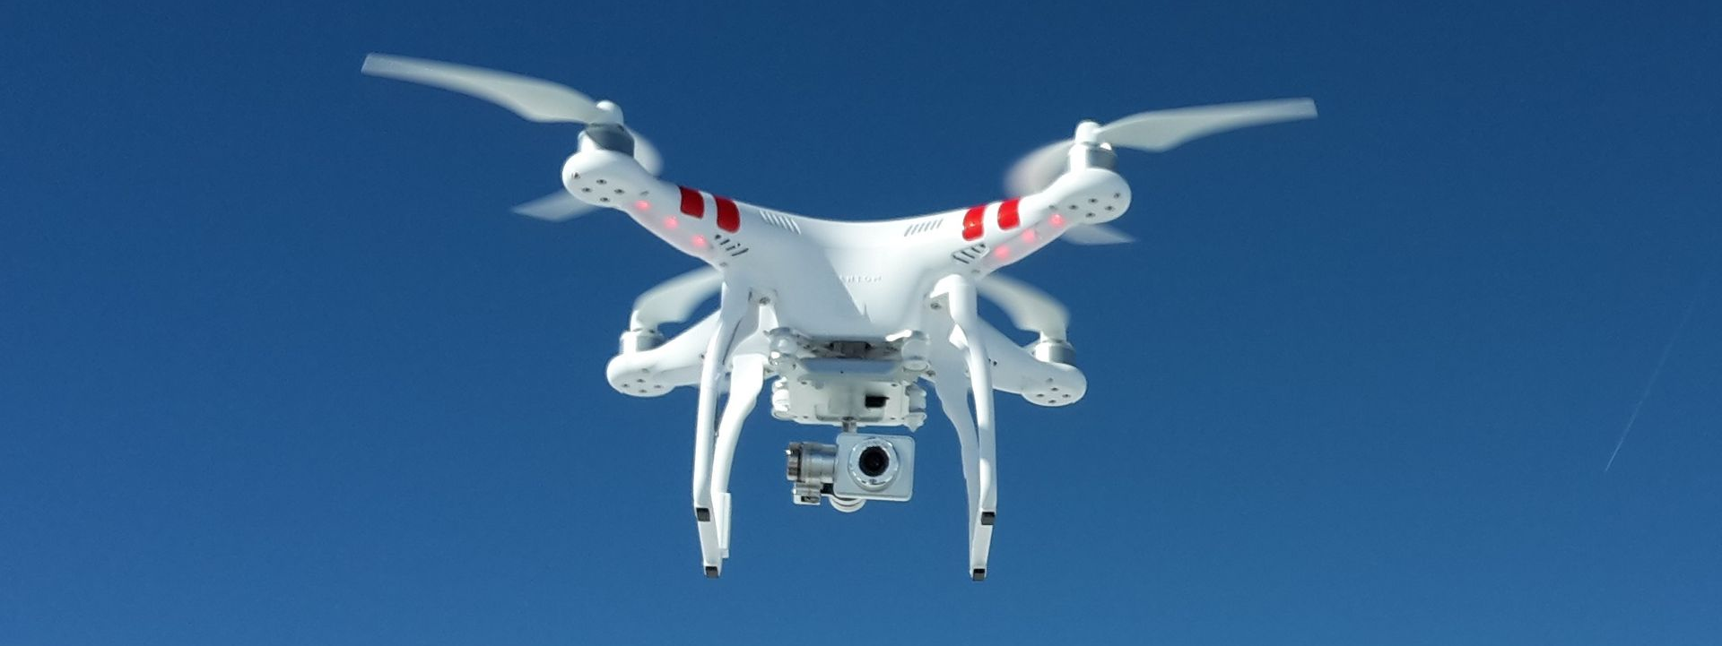
Overview
Context, introduction, and literature review
Problem description
Problem formulation
Potential use in practice
Conclusions and future work

Slide 3
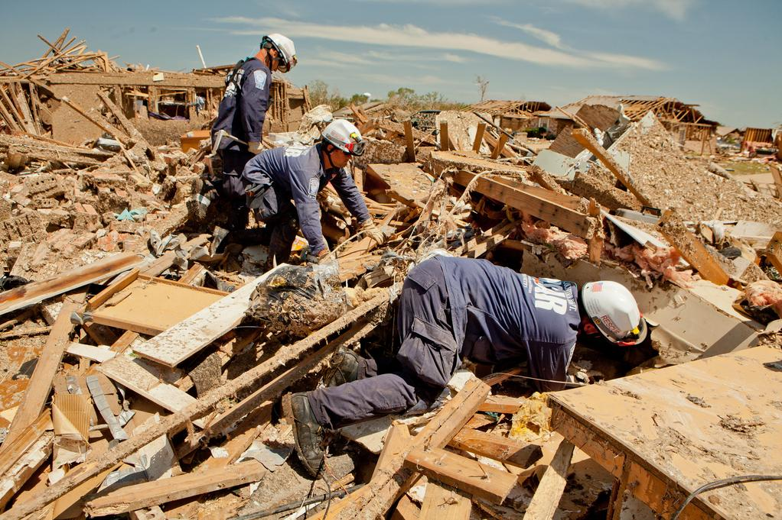
Context
In the aftermath of a disaster, often rescuers are tasked with locating victims trapped and in need of aid:
Most search and rescue procedures are incredibly manual with rescuers approaching collapsed structures.
After a disaster, human rescuers using tools such as dogs, acoustic sensors, and snake cameras to locate people.
Explosion of cell phone usage around the world:
Cellphones emit a host of signals by virtue of being on and active.
Research has begun to explore the ability to passively or actively detect or interact with these signals.
FEMA Urban Search and Rescue team members search house to house for survivors in tornado devastated neighborhood in Moore, Oklahoma. Andrea Booher for FEMA

Slide 4
Introduction
Some organizations and research institutions are adding a new dimension to their search and rescue operations by using UAVs and drones;
Drones have an obvious utility with the ability to fly over a disaster area;
Attaching a wireless sensor, a device to detect cell phones, to the done can allow the drone to locate cell phone users in a region;
Drones have a hard endurance constraint (flight time) and cannot usually cover the entire search area alone.
There is the potential but underexplored use of drones to be used in urban search and rescue operations.

Slide 5
Literature Review (1/3)
When cross referencing the use of UAVs and Drones, USAR operations, and using wireless sensors; Few papers are yielded
Some of the authors attempt to demonstrate using drones to help establish wireless networks using software on cellphones
Most wireless sensor analysis or feasibility occurs in the Wilderness SAR context,
That is, attempting to find one person or a group of people missing in a search area,
Literature does deem the technology feasible (locate device).
If a disaster is cited, usually an earthquake versus a meteorological event.
Notes:
Heavy amount of literature out of turkey

Slide 6
Literature Review (2/3)
Since few are in a USAR context, there is an opportunity to explore this tool to assist rescuers in locating victims and potential victims.
One of the best demonstration studies on the matter was from Beck, et al (2018) where the authors propose a system for assisting in locating people in need of aid after the Haitian earthquake in 2010
Authors outline a method of how drones can survey the island to identify the location of people
Beck, Zoltan, et al. “Collaborative Online Planning for Automated Victim Search in Disaster Response.” Robotics and Autonomous Systems, vol. 100, 2018, pp. 251–266., doi:10.1016/j.robot.2017.09.014.

Slide 7
Literature Review (3/3)
As most literature is in a WiSAR context, most applications envision an unconstrained search area,
Therefore, most applications do not account for a constrained search area.
In addition, WiSAR operations usually are tasked with finding a singular person or group that is missing, rather than accounting for people who might not be in need of aid.

Slide 8
Problem Description (1/2)
Envision the search area discretized in into scanning areas,
A drone with a wireless sensor, and others, attached will fly to and scan a scanning area,
Drones have a hard endurance constraint, flight time,
Drones will consume flight time along the route and at each scanning site.

Slide 9
Problem Description (2/2)
Formulation envisioned as a distance-constrained capacity vehicle routing problem (DCVRP).
Began with formulation from Kek, et al (2008) and modified to suit the problem here,
Notable change: the DCVRP is usually outlined as having a different resource consumed at the nodes (customers) and on the arc (enroute).
In a post-disaster context: time windows less important than overall service time.

Slide 10
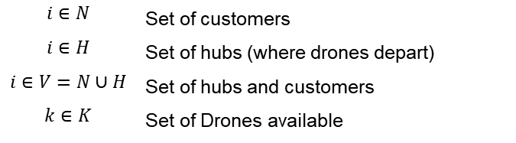

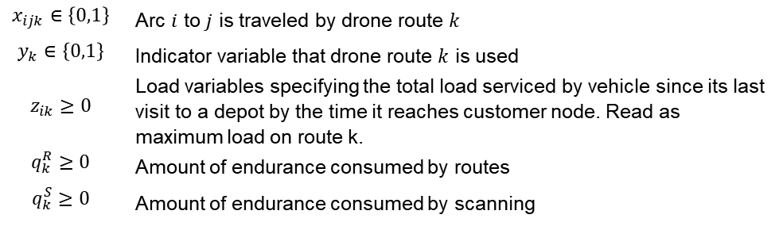
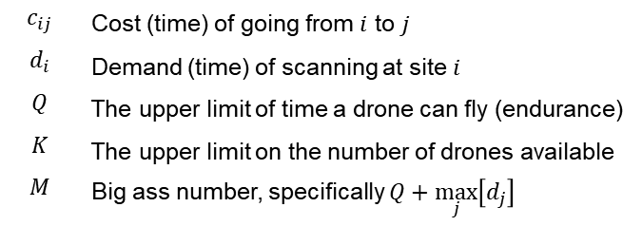
Problem Formulation and Constraints (1/2)
Sets:
Parameters:
$$i∈N$$ | Set of customers
$$i∈H$$ | Set of hubs (where drones depart)
$$i∈V=N∪H$$ | Set of hubs and customers
$$k∈K$$ | Set of Drones available
$$c_{ij}$$ | Cost (time) of going from $i$ to $j$
$$d_{i}$$ | Demand (time) of scanning at site $i$
$$Q$$ | The upper limit of time a drone can fly (endurance)
$$K$$ | The upper limit on the number of drones available
$$M$$ | Big ass number, specifically $Q+\max_{j}\left[d_{j}\right]$
Variables:
$$x_{ijk}∈\left\{0,1\right\}$$ | Arc $i$ to $j$ is traveled by drone route $k$
$$y_{k}∈\left\{0,1\right\}$$ | Indicator variable that drone route $k$ is used
$$z_{ik}≥0$$ | Load variables specifying the total load serviced by vehicle since its last visit to a depot by the time it reaches customer node. Read as maximum load on route k.
$$q_{k}^{R}≥0$$ | Amount of endurance consumed by routes
$$q_{k}^{S}≥0$$ | Amount of endurance consumed by scanning

Slide 11
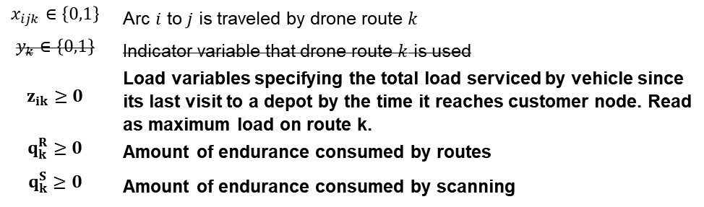
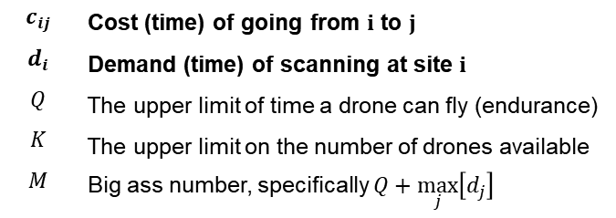
Problem Formulation and Constraints (1/2)
Sets:
Parameters:
$$i∈N$$ | Set of customers
$$i∈H$$ | Set of hubs (where drones depart)
$$i∈V=N∪H$$ | Set of hubs and customers
$$k∈K$$ | Set of Drones available
$$c_{ij}$$ | Cost (time) of going from $i$ to $j$
$$d_{i}$$ | Demand (time) of scanning at site $i$
$$Q$$ | The upper limit of time a drone can fly (endurance)
$$K$$ | The upper limit on the number of drones available
$$M$$ | Big ass number, specifically $Q+\max_{j}\left[d_{j}\right]$
Variables:
$$x_{ijk}∈\left\{0,1\right\}$$ | Arc $i$ to $j$ is traveled by drone route $k$
$$y_{k}∈\left\{0,1\right\}$$ | Indicator variable that drone route $k$ is used
$$z_{ik}≥0$$ | Load variables specifying the total load serviced by vehicle since its last visit to a depot by the time it reaches customer node. Read as maximum load on route k.
$$q_{k}^{R}≥0$$ | Amount of endurance consumed by routes
$$q_{k}^{S}≥0$$ | Amount of endurance consumed by scanning

Slide 12
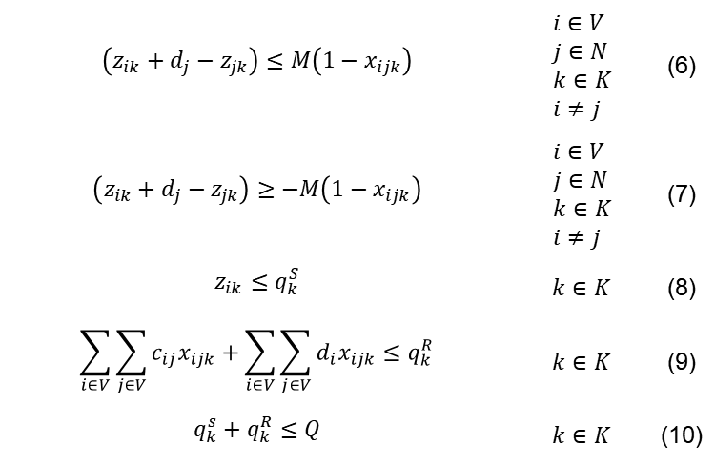
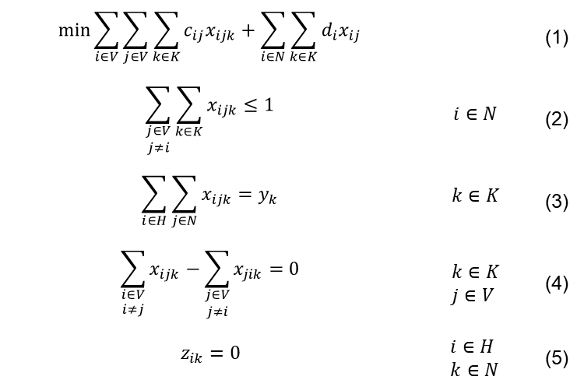
Problem Formulation and Constraints (2/2)
$$\min{\sum_{i∈V}{\sum_{j∈V}{\sum_{k∈K}{c_{ij}x_{ijk}}}}+\sum_{i∈N}{\sum_{k∈K}{d_{i}x_{ij}}}}$$ |  | (1)
$$\sum_{\begin{aligned}j∈V \\ j≠i\end{aligned}}{\sum_{k∈K}{x_{ijk}}}≤1$$ | $$i∈N$$ | (2)
$$\sum_{i∈H}{\sum_{j∈N}{x_{ijk}}}=y_{k}$$ | $$k∈K$$ | (3)
$$\sum_{\begin{aligned}i∈V \\ i≠j\end{aligned}}{x_{ijk}}−\sum_{\begin{aligned}j∈V \\ j≠i\end{aligned}}{x_{jik}}=0$$ | $$k∈K \\ j∈V$$ | (4)
$$z_{ik}=0$$ | $$i∈H \\ k∈N$$ | (5)
$$\left(z_{ik}+d_{j}−z_{jk}\right)≤M\left(1−x_{ijk}\right)$$ | $$i∈V \\ j∈N \\ k∈K \\ i≠j$$ | (6)
$$\left(z_{ik}+d_{j}−z_{jk}\right)≥−M\left(1−x_{ijk}\right)$$ | $$i∈V \\ j∈N \\ k∈K \\ i≠j$$ | (7)
$$z_{ik}≤q_{k}^{S}$$ | $$k∈K$$ | (8)
$$\sum_{i∈V}{\sum_{j∈V}{c_{ij}x_{ijk}}}+\sum_{i∈V}{\sum_{j∈V}{d_{i}x_{ijk}}}≤q_{k}^{R}$$ | $$k∈K$$ | (9)
$$q_{k}^{s}+q_{k}^{R}≤Q$$ | $$k∈K$$ | (10)

Slide 13
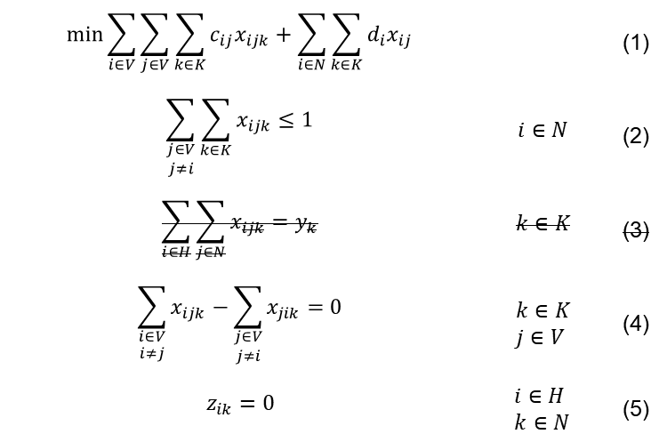
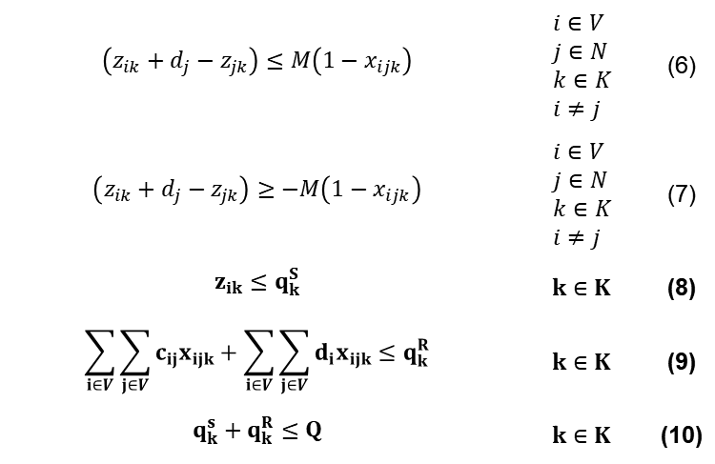
Problem Formulation and Constraints (2/2)
$$\min{\sum_{i∈V}{\sum_{j∈V}{\sum_{k∈K}{c_{ij}x_{ijk}}}}+\sum_{i∈N}{\sum_{k∈K}{d_{i}x_{ij}}}}$$ |  | (1)
$$\sum_{\begin{aligned}j∈V \\ j≠i\end{aligned}}{\sum_{k∈K}{x_{ijk}}}≤1$$ | $$i∈N$$ | (2)
$$\sum_{i∈H}{\sum_{j∈N}{x_{ijk}}}=y_{k}$$ | $$k∈K$$ | (3)
$$\sum_{\begin{aligned}i∈V \\ i≠j\end{aligned}}{x_{ijk}}−\sum_{\begin{aligned}j∈V \\ j≠i\end{aligned}}{x_{jik}}=0$$ | $$k∈K \\ j∈V$$ | (4)
$$z_{ik}=0$$ | $$i∈H \\ k∈N$$ | (5)
$$\left(z_{ik}+d_{j}−z_{jk}\right)≤M\left(1−x_{ijk}\right)$$ | $$i∈V \\ j∈N \\ k∈K \\ i≠j$$ | (6)
$$\left(z_{ik}+d_{j}−z_{jk}\right)≥−M\left(1−x_{ijk}\right)$$ | $$i∈V \\ j∈N \\ k∈K \\ i≠j$$ | (7)
$$z_{ik}≤q_{k}^{S}$$ | $$k∈K$$ | (8)
$$\sum_{i∈V}{\sum_{j∈V}{c_{ij}x_{ijk}}}+\sum_{i∈V}{\sum_{j∈V}{d_{i}x_{ijk}}}≤q_{k}^{R}$$ | $$k∈K$$ | (9)
$$q_{k}^{s}+q_{k}^{R}≤Q$$ | $$k∈K$$ | (10)
Notes:
I would like to draw your attention to the constraints bolded here. These are modified from the base formulation to combine the consumption in both the route and at sites. Recall that $z_{ik}$ is the amount of energy consumed in route k at customer i.

Slide 14
Potential use in practice
On May 20, 2013, a EF-5 tornado struck central Oklahoma causing extensive damage to communities of Newcastle, Oklahoma City, and Moore
FEMA Urban Search and Rescue team members search house to house for survivors in tornado devastated neighborhood in Moore, Oklahoma. Andrea Booher for FEMA

Slide 15
Why tornadoes and Moore-Newcastle?
Availability of data; the disaster occurred in 2013 and there is an availability of digitized and public data for the disaster.
Relative to an earthquake or hurricane, Tornadoes have destruction area which is physically smaller in area.
Predictability of tornado is greater than that of an earthquake, and a tornado will dissipate quicker than a hurricane (i.e. allow for a timely rescue operation)
The number of tornado incidents in the United States is approximately 1200 with approximately 37 EF-3 to EF-5 tornadoes occurring in the United Sates each year.
The standardization and use of the Enhanced Fujita Scale which accounts for both tornado damage can aid in understanding the effectiveness of the tool over time.

Slide 16
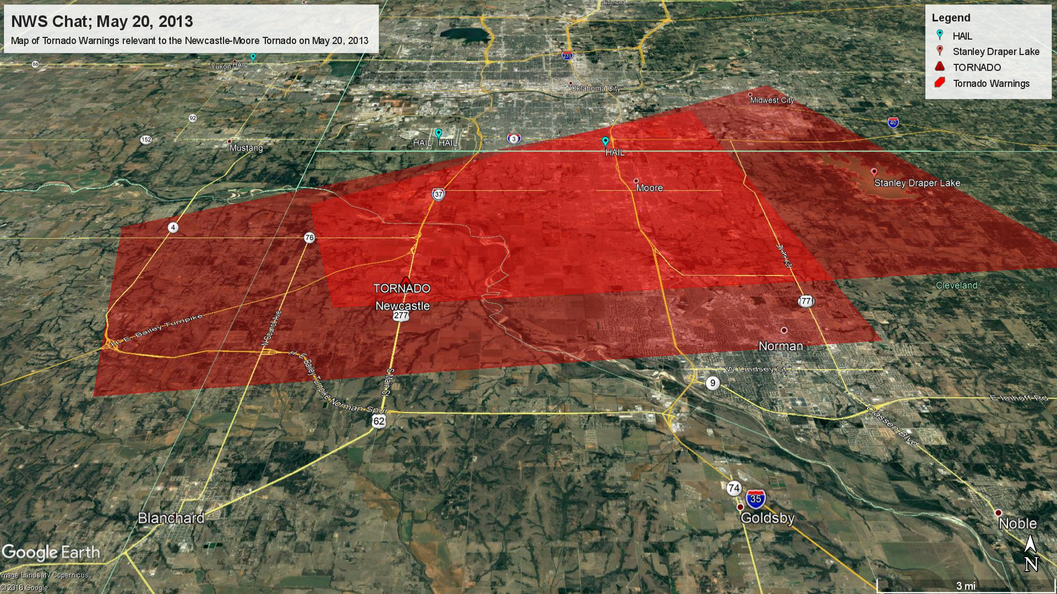
Potential use in practice (1/2)
Anticipate the use of Meteorologists and remote sensing technology to track the occurrence of tornados
Meteorologists at the NWS and SPC typically delineate various severe weather watches and warnings
Actual sightings can trigger which polygons to begin searching

Slide 17
Potential use in practice (2/2)
Notes:
Local media reported a tornado around 2:56pm, estimated the path length to be 20 miles (32km), and lifted around 3:36 pm around Stanley Draper Lake
These two tornado warnings encompass the two points what a tornado was searched, the sum of the area is approximately 730km^2, 40km at its longest, 16km at its widest.

Slide 18
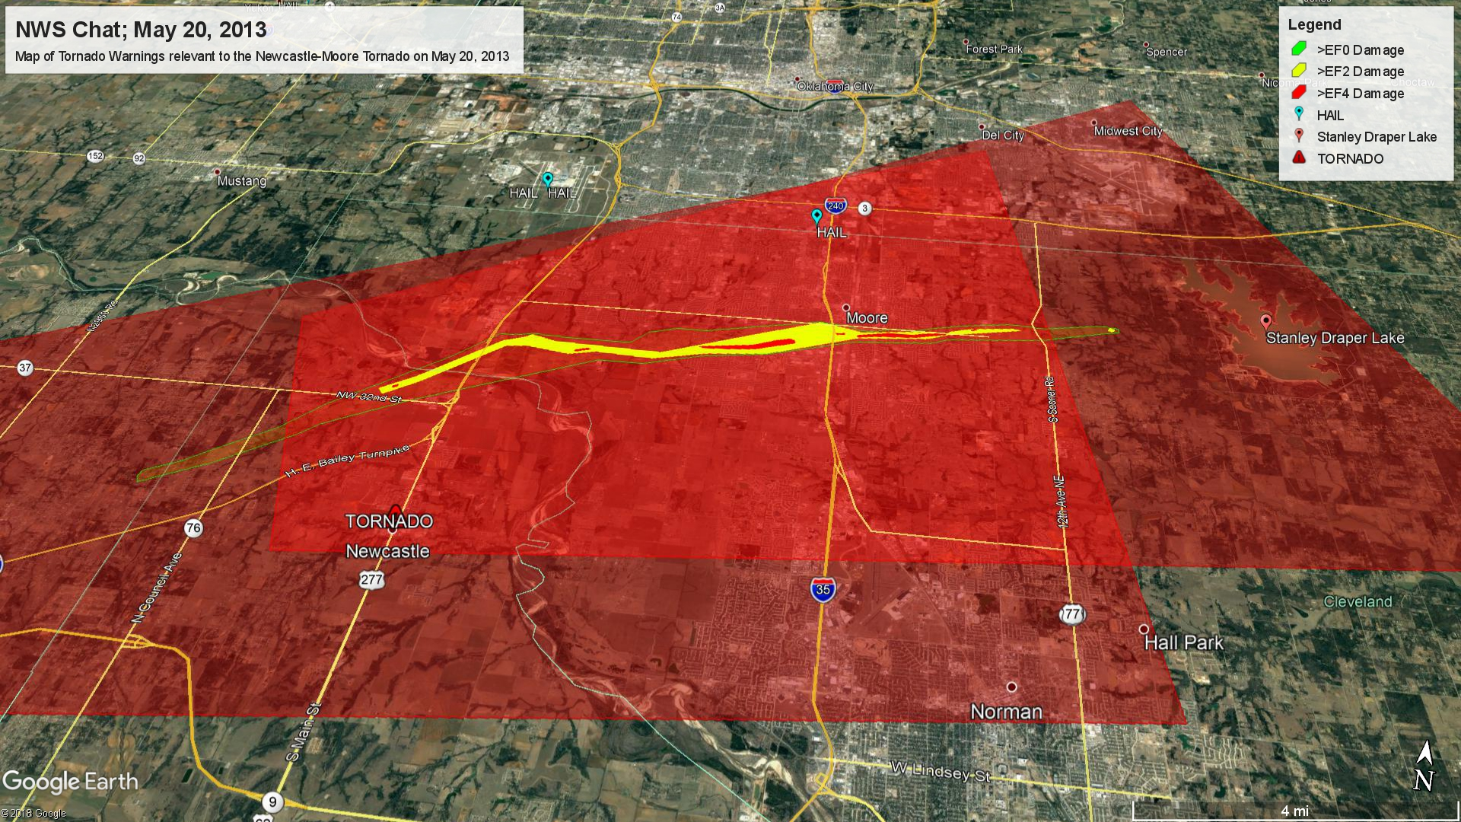
Limitations
Notes:
The Enhanced Fajita scale is a method of determining damage of a tornado
Damage is assessed by engineers and rescuers on the ground after a disaster.
The watch polygon is delineated at over 700km^2 with the EF0 damage polygon is at 30km^2
Literature shows that the devices can effectively detect mobile devices up to 300m away, or cover an area of 0.28km^2 (30 track and field infields)
Approx 2500 units in the search area at about 20m/s , over 14 flight hours to cover the search area

Slide 19
Attempts to better isolate search area
Use roads or existing structures from OpenStreetMap as an indicator
Most buildings and victims would be within 300m of a road
Scanning cornfields is usually unnecessary
Encourage spotters and the media better indicate bearing and direction of tornadoes
Note that severe weather observations are indicated where the spotter is, not the location of the tornado
Most meteorologists during extreme weather events are tasked with updating predictions, not analyzing remote sensing data
Potential there to possibly use meteorologists to assist in delineating a search area.

Slide 20
Conclusions and future steps
Expand the model to incorporate priority search areas
Incorporate a Dynamic Vehicle Routing (DVRP) into the search algorithm and incorporate damage reports as they happen to increase the priority of search area
Best indicator of damaged property is damaged property

Slide 21
Questions?

